Slide 1

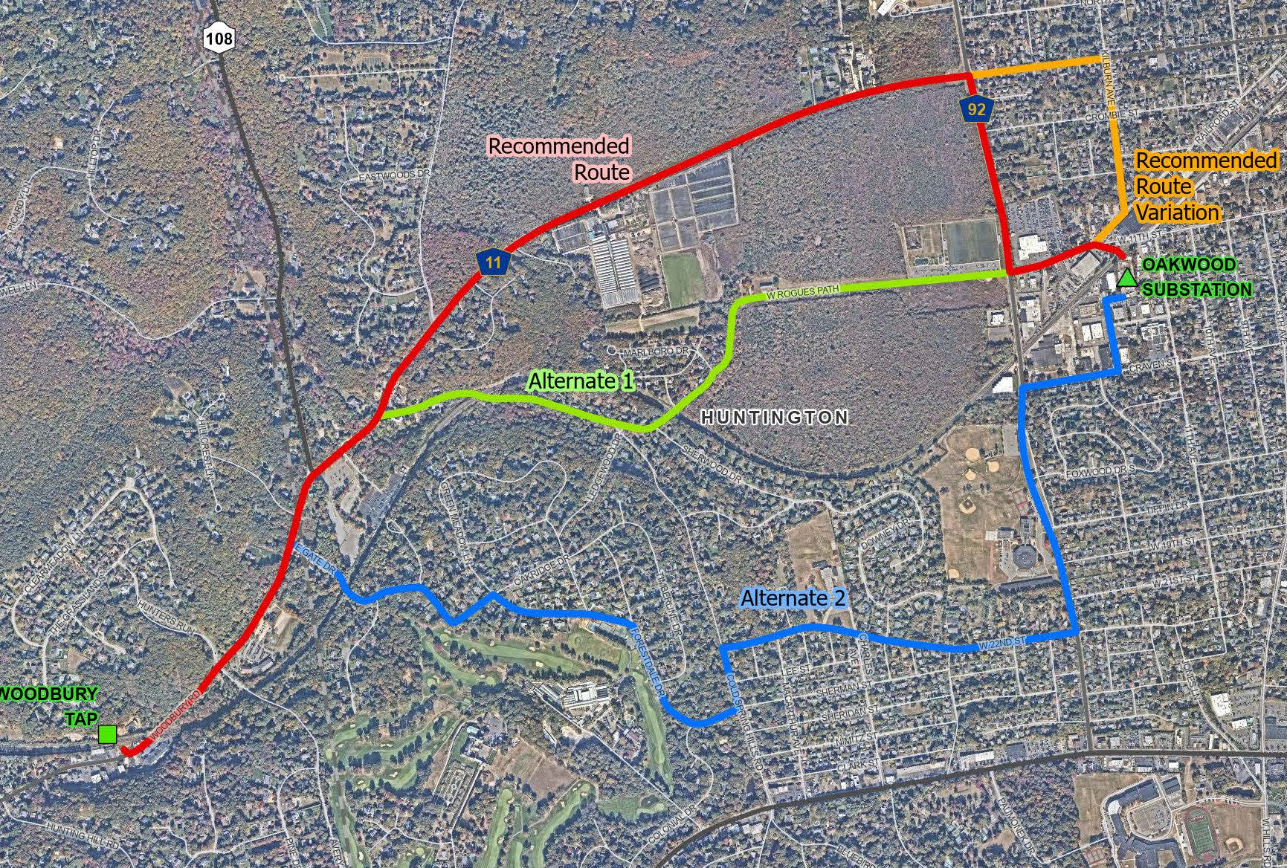
Syosset to Oakwood Project
PSEG Long Island is committed to delivering best-in-class system reliability by expanding electrical capacity to meet the energy needs of the communities it serves, today and in the future.
Project Overview & Benefits
PSEG Long Island, as the agent of LIPA, is proposing the Syosset to Oakwood Project, to meet current and future capacity needs, and to maintain safe, reliable, and robust service in the area. The Project would include the installation of a new approximately 2.8-mile 138kV underground electric transmission line between the Woodbury Tap in Woodbury, Nassau County, to the Oakwood Substation in Huntington Station, Suffolk County. The new 138kV underground transmission line is proposed to occur primarily within the public rights-of-way along Woodbury Road, West Pulaski Road, Oakwood Road, and West 11th Street.
The Syosset to Oakwood Project includes the installation of new riser poles and overhead transmission poles at the Woodbury Tap. This Project also includes upgrades to the Oakwood Substation and the installation of new overhead equipment. Modifications will also be made to existing lines 138-675 and 138-676, which both run from the Woodbury Tap to the Oakwood Substation.
Benefits Include:
The new 138kV electric transmission cable will help ensure continued reliable service. The proposed 138kV supply circuit from the Woodbury Tap to the Oakwood Substation will enhance reliability and increase load capacity to the existing transmission system.
The Project will be located primarily under roads and other public rights-of-way.
The new 138kV cable will be located underground except for certain above-ground electrical equipment and structures at the Woodbury Tap and Oakwood Substation.
Project Area:
New York State Public Service Commission Article VII Information
After the Project's amendment application is filed and the Commission assigns a case number to the Project, the case number will be provided on the Project's website. Then, the amendment application and related case documents can be accessed on the PSC website (www.dps.ny.gov) by clicking "File Search" and filling in the case number. This will bring up the main Document and Matter Management (“DMM”) page(s) for this case, where the materials are located
In addition, interested persons who wish to participate as parties in this case may file for party status. On the DMM page for this case, the prospective party should click the button at the upper right labeled “Request for Party Status” to see a Public Service Commission web page with instructions for the procedures to follow to become a party.
For Questions About the Syosset to Oakwood Project,
Call or Text 631-792-6866 Email info@Syosset2Oakwood.com Visit www.Syosset2Oakwood.com

Slide 2
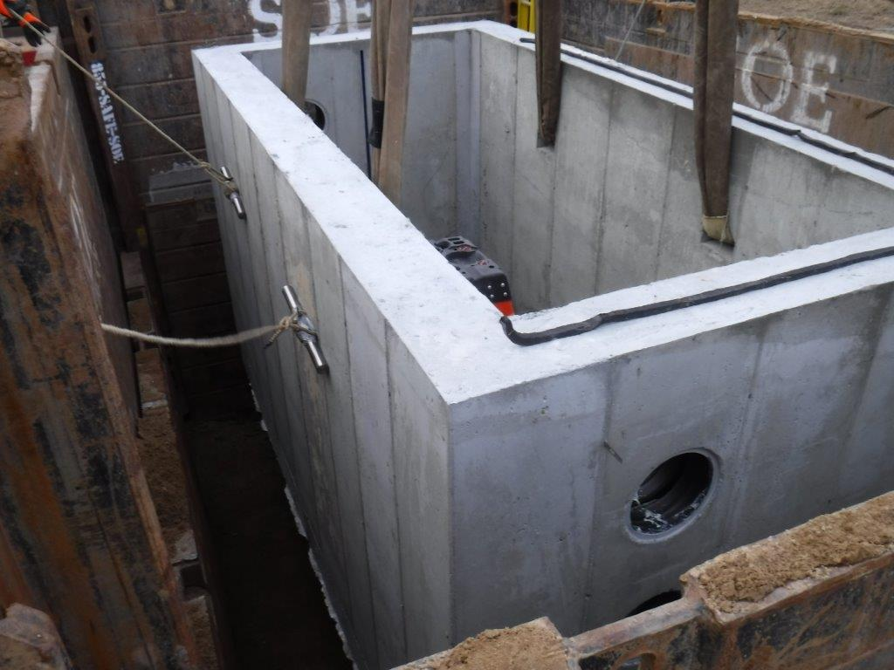
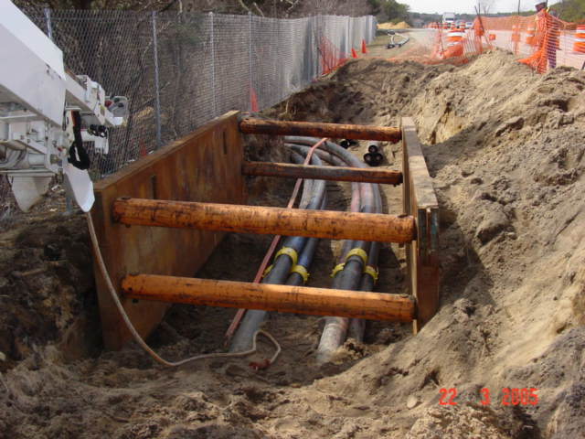
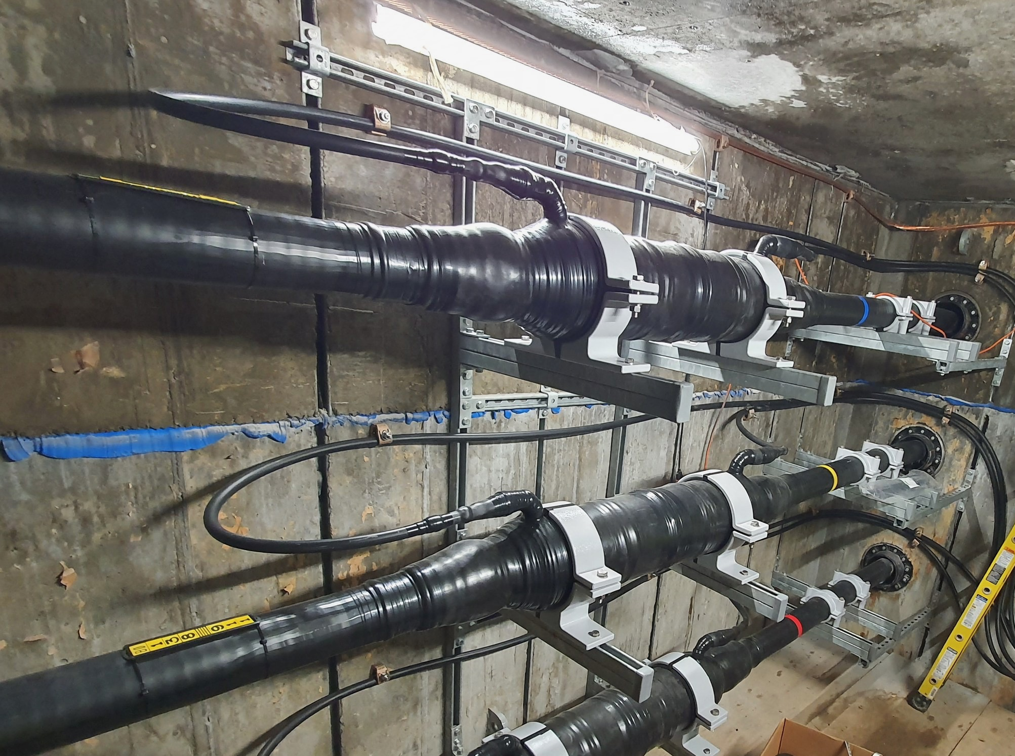
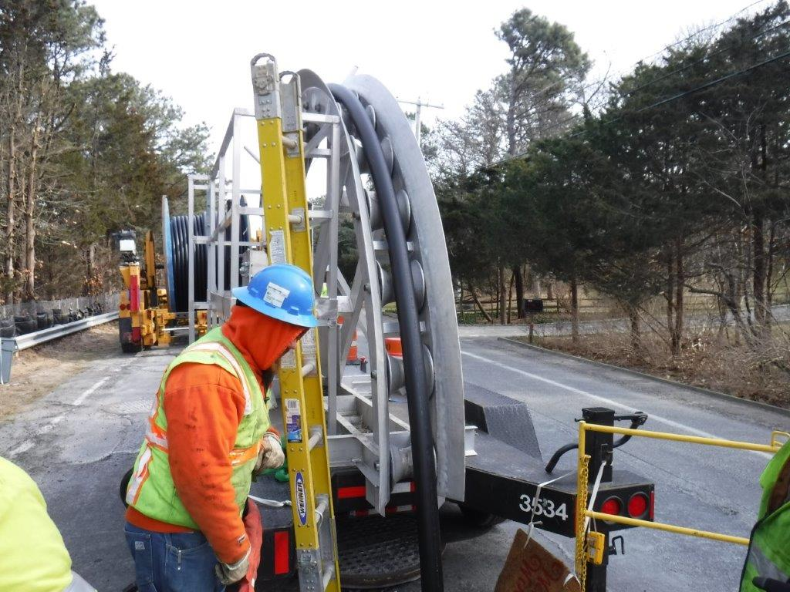
Syosset to Oakwood Project
Underground Transmission Construction Process
Splice Vaults Installation:
Underground vaults will be installed at intervals along the route to splice together underground cable.
Conduit Installation:
During the installation process, crews will route the new conduits to the new splice vaults.
Restoration:
After completing the installation of the vaults, any excavated and disturbed areas will be restored.
Cable Installation:
Underground cable arrives on trucks specifically designed for their installation. Crews will pull cable from one vault to another along the project route.
Cable Splicing:
Crews will set up a climate-controlled environment at each vault location to splice the underground cables together. This activity is continuous for approximately one week for each vault.
Overhead Transmission Construction Process
Overhead transmission and riser structures will be installed at the Woodbury Tap and overhead structures will be installed at the Oakwood Substation. The new structures will be within LIPA property and will connect the new underground transmission line to existing structures.
Vault Installation
Conduit Installation
Cable Splicing
Cable Installation
Permitting & Consultation Process
To construct the Project, PSEG Long Island will need, in addition to other necessary permits:
The New York State Public Service Commission's issuance of an Article VII Certificate of Environmental Compatibility and Public Need and approval of an Environmental Management & Construction Plan (EM&CP).
Approval from or consultation with the New York Department of Environmental Conservation, and New York State Office of Parks, Recreation & Historic Preservation.
Consultation with Nassau County, Suffolk County, Town of Oyster Bay, and Town of Huntington.
For Questions About the Syosset to Oakwood Project,
Call or Text 631-792-6866 Email info@Syosset2Oakwood.com
Visit www.Syosset2Oakwood.com
For Questions About the Syosset to Oakwood Project,
Call or Text 631-792-6866 Email info@Syosset2Oakwood.com Visit www.Syosset2Oakwood.com

